Slide 1

Human-Following Mobile Robot
Group Name: Gravity-N1
Members：LIU Ben, ZHANG Jiahao, LI hui,
SHI Feifei, FENG Zicheng, ZHANG Cheng
Github:https://github.com/Gravity-N1

Slide 2
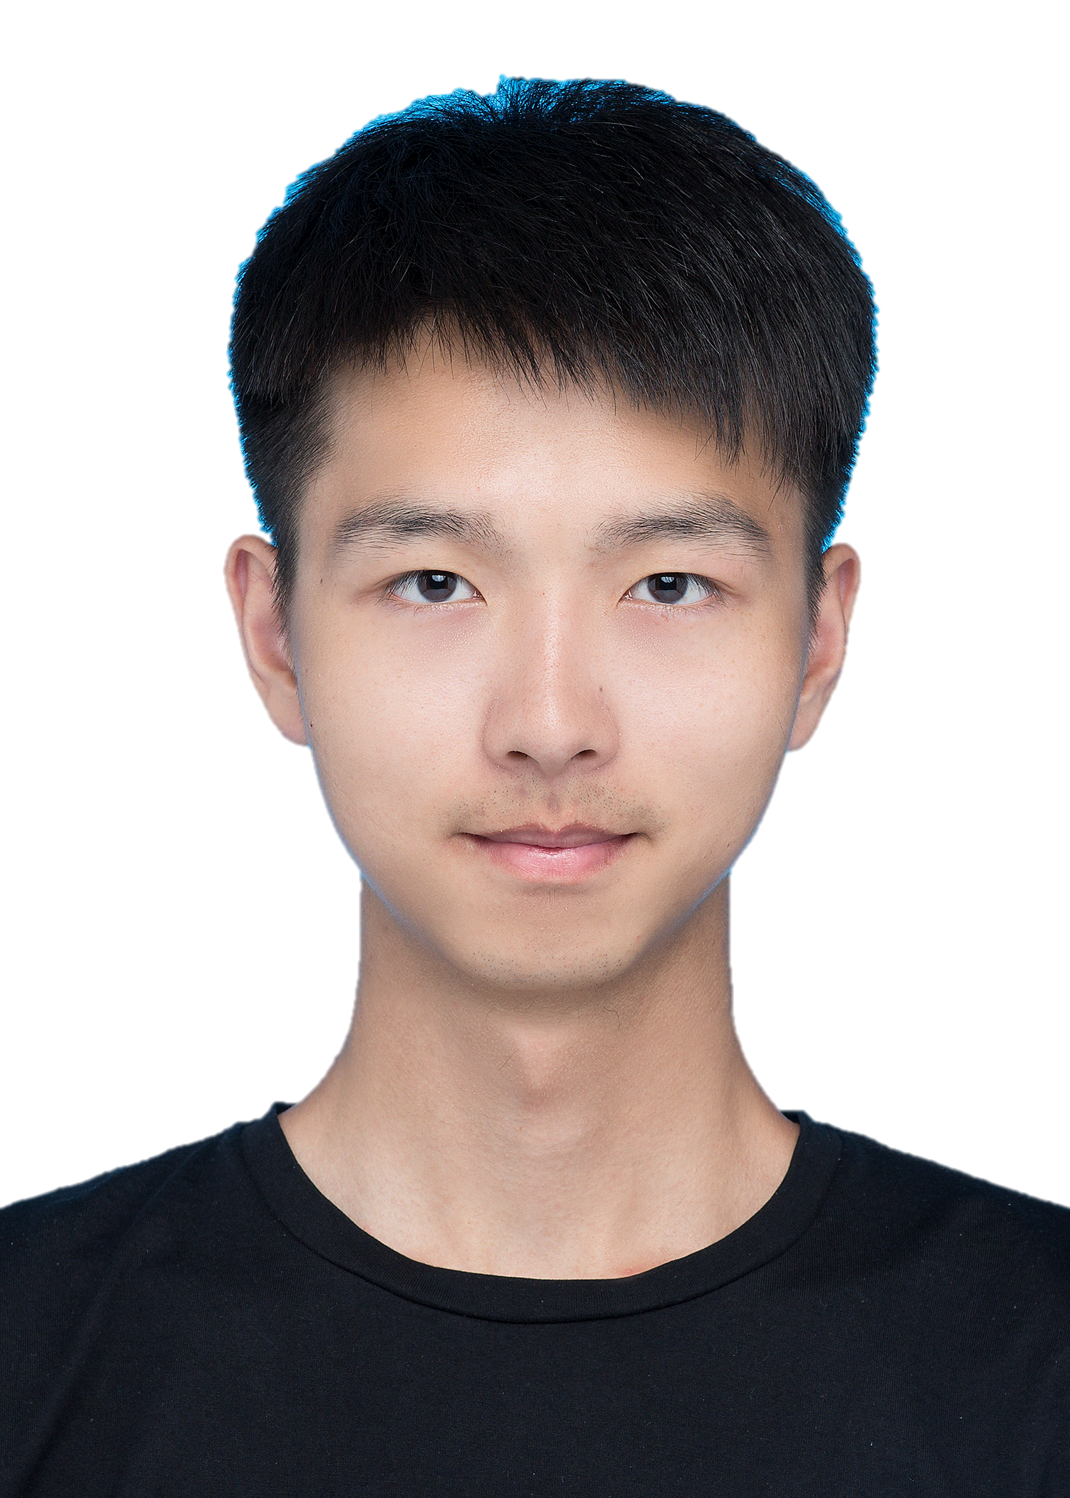
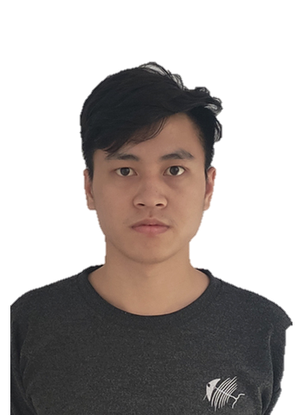
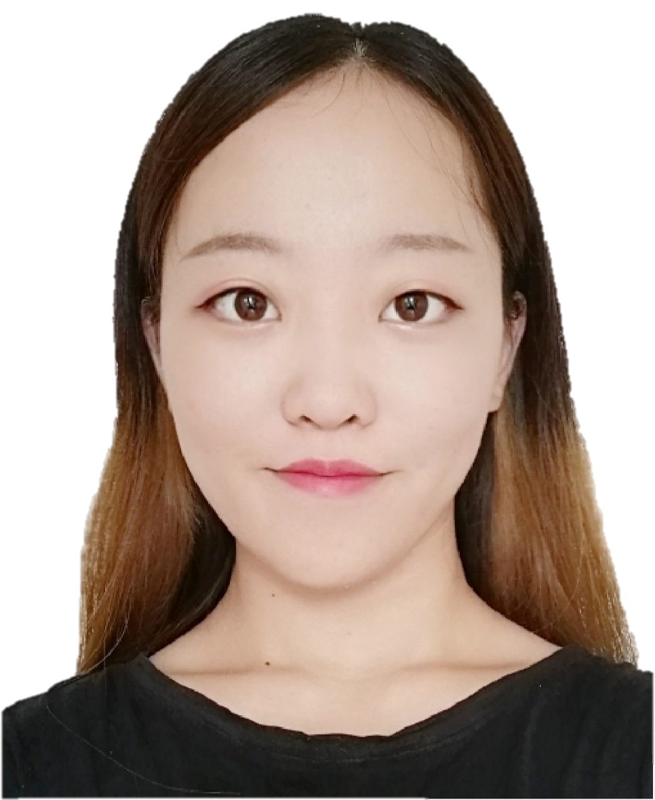
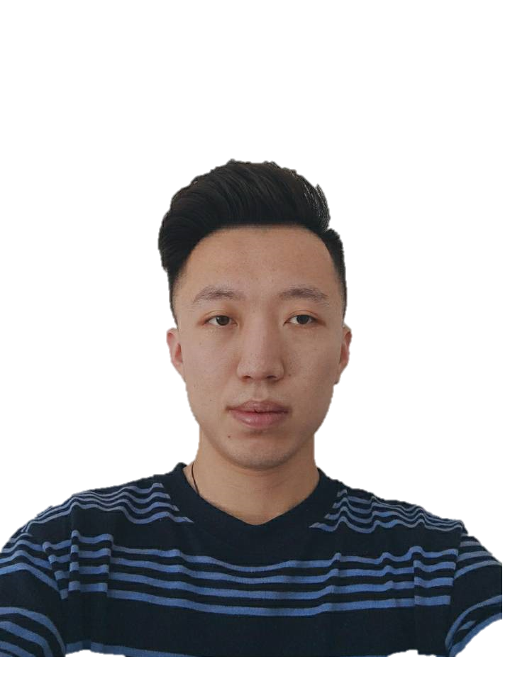
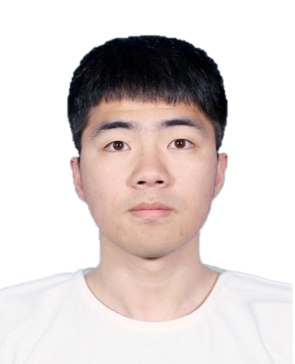
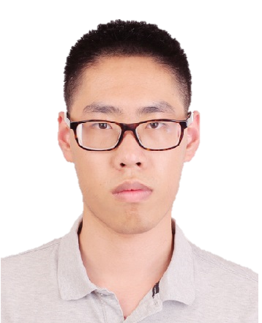
Team members
LIU Ben
Group Master &
Development team
LI Hui
Product Manager &
Development team
SHI Feifei
Chief financial officer & Development team
ZHANG Cheng
Development team
FENG Zicheng
Development team
ZHANG Jiahao
Development team

Slide 3
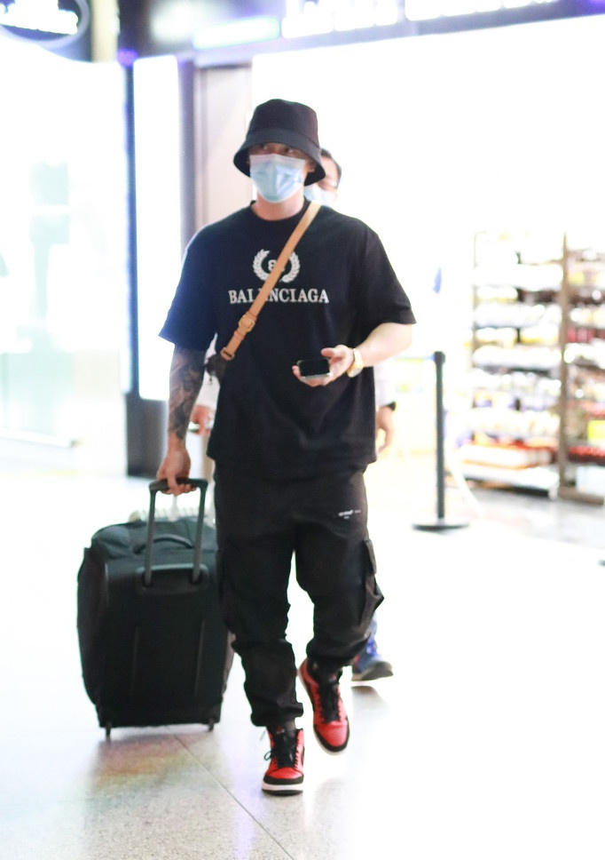
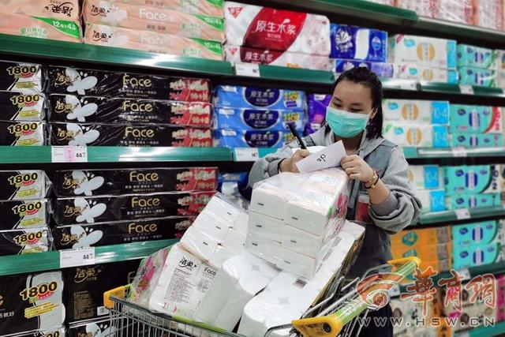
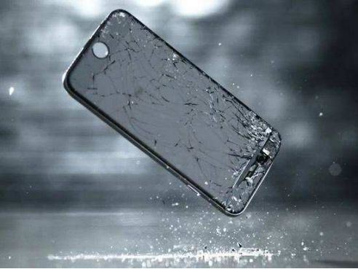
Project background
Walk while playing mobile phone
Supermarket shelves

Slide 4
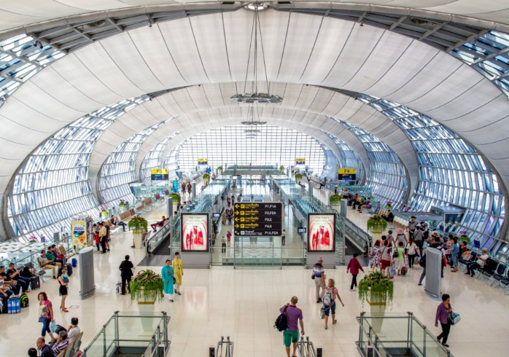
Project background
Airport
Big space
Crowd density
Almost everyone has a suitcase
Road surface suitable for car movement

Slide 5
Significant
Make people focus on interesting things
Reduce the labor intensity of cargo handlers
Improve worker productivity

Slide 6




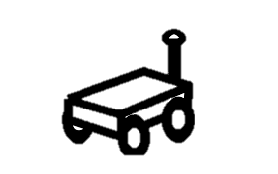
General plan
UWB
Previous plan
Real time route plan

Slide 7





General plan
We have passion!
Motivation
Feasibility
Visibility
What’s Linux?
What’s Ros?
What’s ……
Have a good budget

Slide 8
General plan
UWB
Final plan
Follow Path

Slide 9

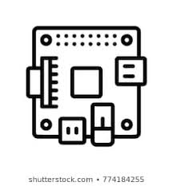



General plan
Hui & SHI: generate the path and based on UWB and make sure the when stop when continue.
Path generate
ZHANG: Control the mobile robot based on control singals
Tag locations
Stm32
When stop
UWB
Any obstacles ？
Collision avoidance
FENG: send location of people and the robot to Raspberry Pi
Ben & Jiahao: Determine if there is an obstacle in front of the robot

Slide 10

UWB Localization
Anchor
Anchor
Anchor
Tag
Anchor
Tag

Slide 11
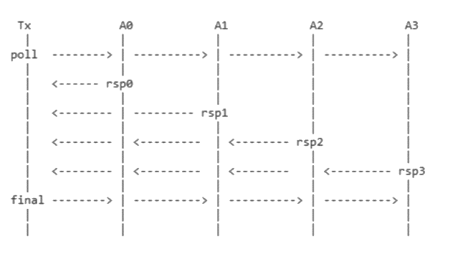
Ranging
When anchor receive poll from a tag, it will response with Time of Flight(TOF) after ranging. (10 times per sec)
The UWB modules were modified so that: when anchor receive poll from Tag1 (user), it will send response to both Tag1 and Tag0 (robot)

Slide 12
Filtering
The raw data of ranging can varies in 20 cm even in static because of noise. It brings big uncertainty to localization, and smooth data is also required in motor control.
A Kalman filter is used to smooth the ranging data from each anchor

Slide 13
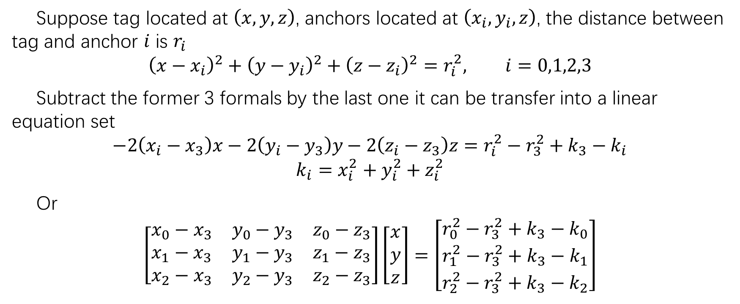
Calculation of coordinate
Suppose tag located at $\left(x,y,z\right)$, anchors located at $\left(x_{i},y_{i},z\right)$, the distance between tag and anchor $i$ is $r_{i}$
$${\left(x−x_{i}\right)}^{2}+{\left(y−y_{i}\right)}^{2}+{\left(z−z_{i}\right)}^{2}=r_{i}^{2}, i=0,1,2,3$$
Subtract the former 3 formals by the last one it can be transfer into a linear equation set
$$−2\left(x_{i}−x_{3}\right)x−2\left(y_{i}−y_{3}\right)y−2\left(z_{i}−z_{3}\right)z=r_{i}^{2}−r_{3}^{2}+k_{3}−k_{i}$$
$$k_{i}=x_{i}^{2}+y_{i}^{2}+z_{i}^{2}$$
Or
$$\left[\begin{matrix}x_{0}−x_{3} & y_{0}−y_{3} & z_{0}−z_{3} \\ x_{1}−x_{3} & y_{1}−y_{3} & z_{1}−z_{3} \\ x_{2}−x_{3} & y_{2}−y_{3} & z_{2}−z_{3}\end{matrix}\right]\left[\begin{matrix}x \\ y \\ z\end{matrix}\right]=\left[\begin{matrix}r_{0}^{2}−r_{3}^{2}+k_{3}−k_{0} \\ r_{1}^{2}−r_{3}^{2}+k_{3}−k_{1} \\ r_{2}^{2}−r_{3}^{2}+k_{3}−k_{2}\end{matrix}\right]$$

Slide 14
Calculation of coordinate
This method can determine the location ideal condition. But in real condition, its shortcomings will be exposed in 2 aspects：
The equation become underdetermined when anchors are in the same height.
Small error in ranging might result massive location error
Therefore another algorithm called CHAN is adopted, which is based on Weighted Least Square. This algorithm can produce stable results when ranging error exist.

Slide 15
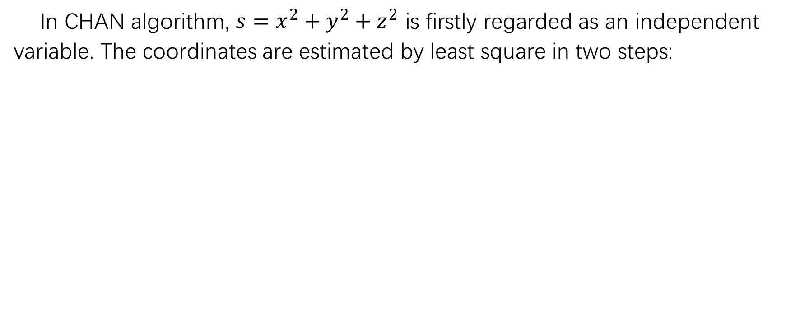
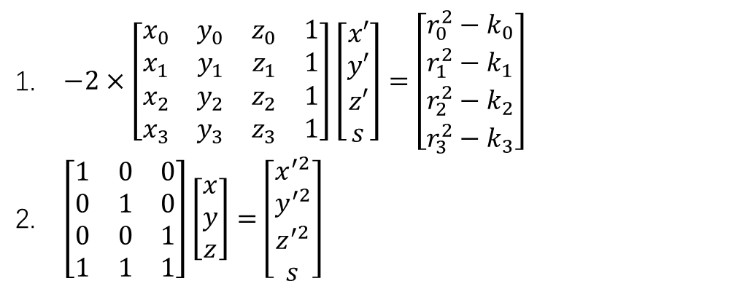
CHAN Algorithm
In CHAN algorithm, $s=x^{2}+y^{2}+z^{2}$ is firstly regarded as an independent variable. The coordinates are estimated by least square in two steps:
$−2×\left[\begin{matrix}x_{0} & y_{0} & z_{0} & 1 \\ x_{1} & y_{1} & z_{1} & 1 \\ x_{2} & y_{2} & z_{2} & 1 \\ x_{3} & y_{3} & z_{3} & 1\end{matrix}\right]\left[\begin{matrix}x′ \\ y′ \\ z′ \\ s\end{matrix}\right]=\left[\begin{matrix}r_{0}^{2}−k_{0} \\ r_{1}^{2}−k_{1} \\ r_{2}^{2}−k_{2} \\ r_{3}^{2}−k_{3}\end{matrix}\right]$
$\left[\begin{matrix}1 & 0 & 0 \\ 0 & 1 & 0 \\ 0 & 0 & 1 \\ 1 & 1 & 1\end{matrix}\right]\left[\begin{matrix}x \\ y \\ z\end{matrix}\right]=\left[\begin{matrix}x^{′2} \\ y^{′2} \\ z^{′2} \\ s\end{matrix}\right]$

Slide 16
Dataflow
UWB
Serial message
Serial Interpreter
Ranging data
Kalman Filter
Ranging data
Route Planning
Data Buffer
Tag position
Coordinate
Estimator

Slide 17
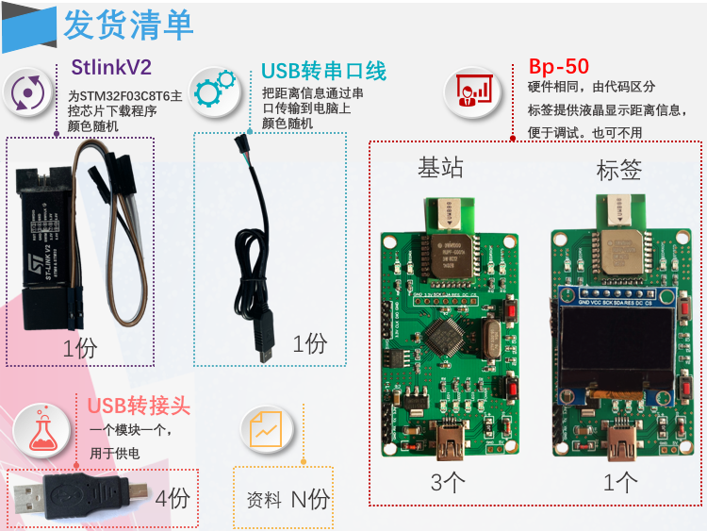
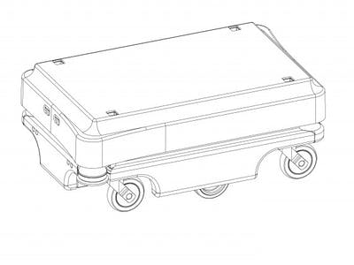
Route Plan
Interpolation
The data refresh rate of tag 1 is 10Hz, and the data refresh rate of AGV car is 1000Hz.
In order to ensure that the car can follow the track of people in real time and accurately, the data of tag 2 needs to be interpolated.
1

Slide 18
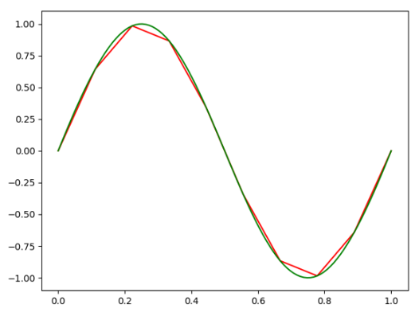
Route Plan
Interpolation
Based on the discrete data, the continuous function is added to make the continuous curve pass through all the given discrete data points.
Lagrange interpolation
Newton interpolation
Piecewise interpolation
Spline interpolation
Trigonometric function interpolation

Slide 19
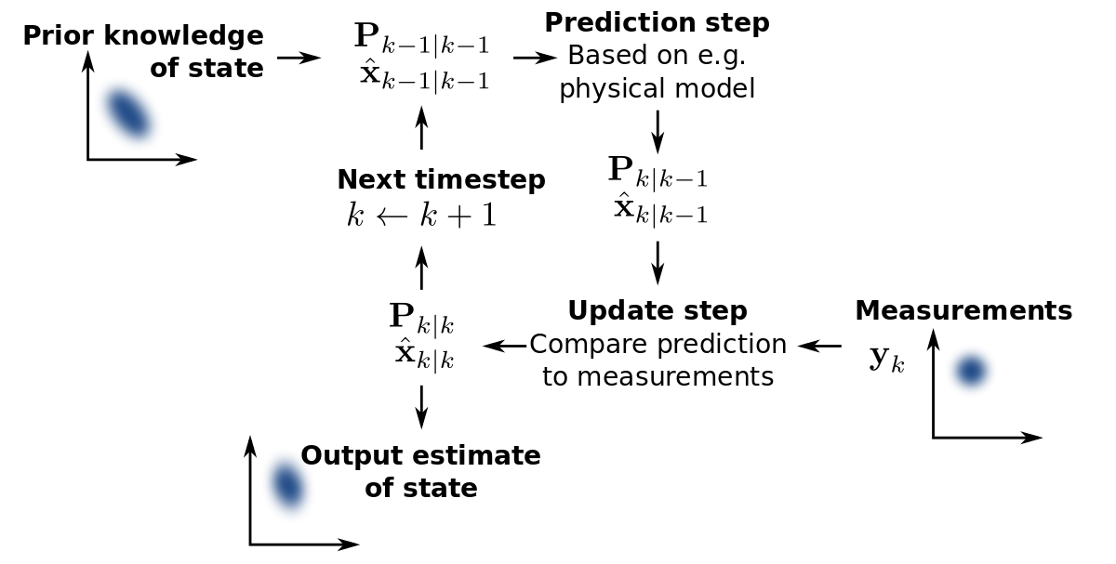
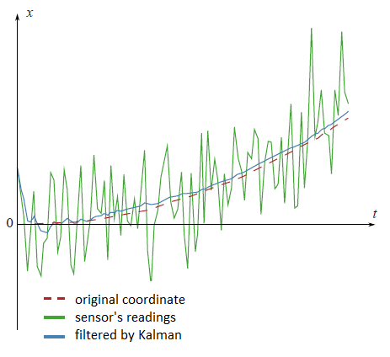
Route Plan
Kalman filtering

Slide 20
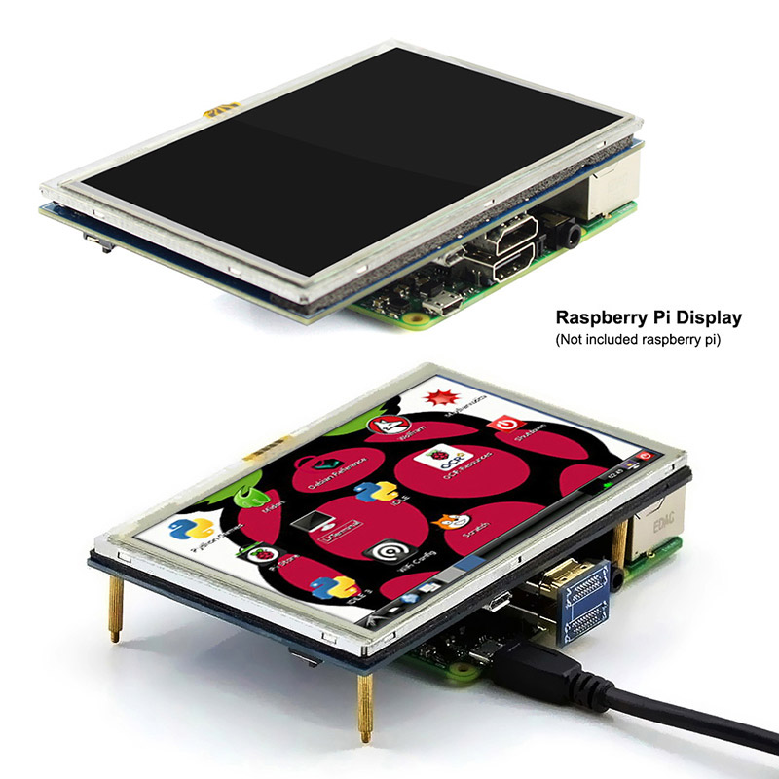
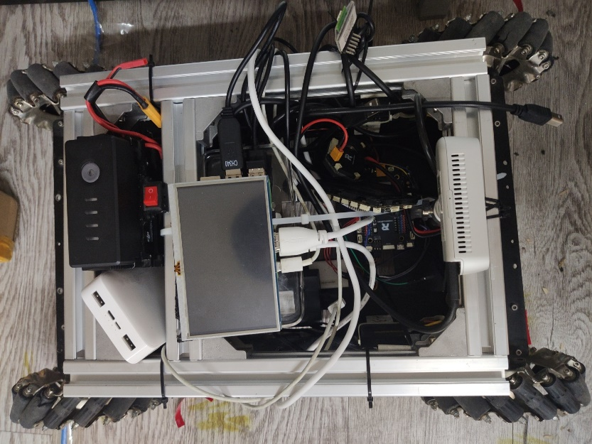
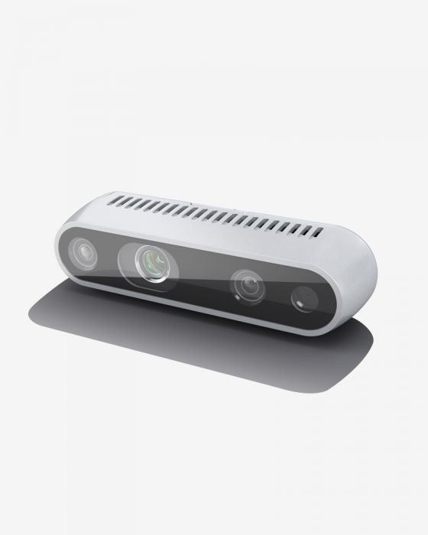
Hardware part of Route Plan
Display some message in screen
Position of people and car
Obstacle in route
Relative distance and angle

Slide 21


Data collection
UWB record people data
UWB record car data
Temporary people location
Judge absolute distance of latest locations
Car location buffer
Delete this data
Valid data
Judge length of buffer
>=100
People location buffer
<100
Delete first data
>=1000
Judge length of buffer
Record data
<1000
Delete first data
Record data

Slide 22






Data processing
Stop message
Move message
Camera data result
Determine whether car can move
<700mm
>=700mm
Distance of car and objective people location
Determine whether the goal
is reached

Slide 23
Communication with car
Encoding format: Eight Bytes Flow
Positive or negative absolute angle judge flag
Positive: 0xFF
Negative: 0x00
Start read flag
Start read: 0xaa
Throw: others
Absolute distance of Car and people
1bytes | 2bytes | 3bytes | 4bytes | 5bytes | 6bytes | 7bytes | 8bytes
Whether move flag
Move: 0xFF
Stop: 0x00
Expend 1000 times Absolute angle of Car and people
End read flag
Start read: 0xff

Slide 24
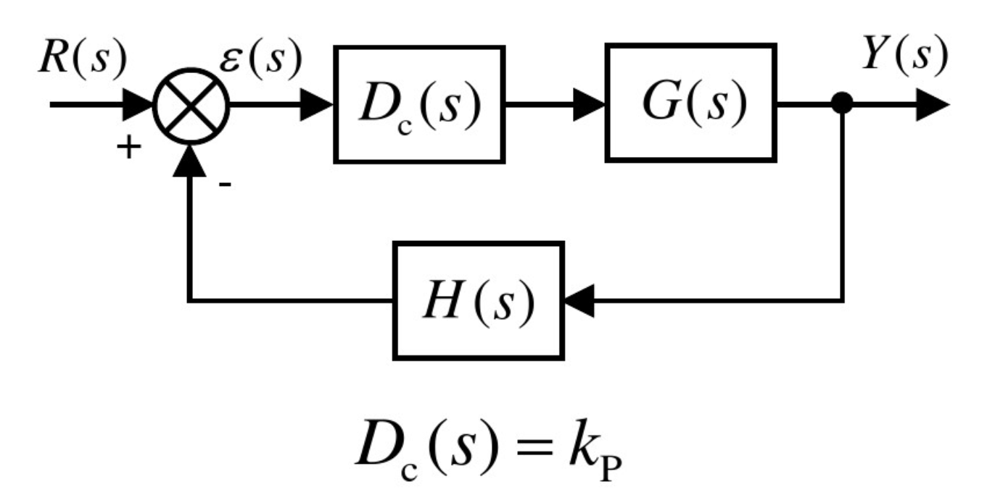
Motor Control – PID Control
P -- Proportional control
When the feedback control signal is linearly proportional to the system error, we call the result Proportional Feedback.
When Kp is made very large, the steady state error will be very small. But the dynamic response will become worse because the damping may be much too low.

Slide 25
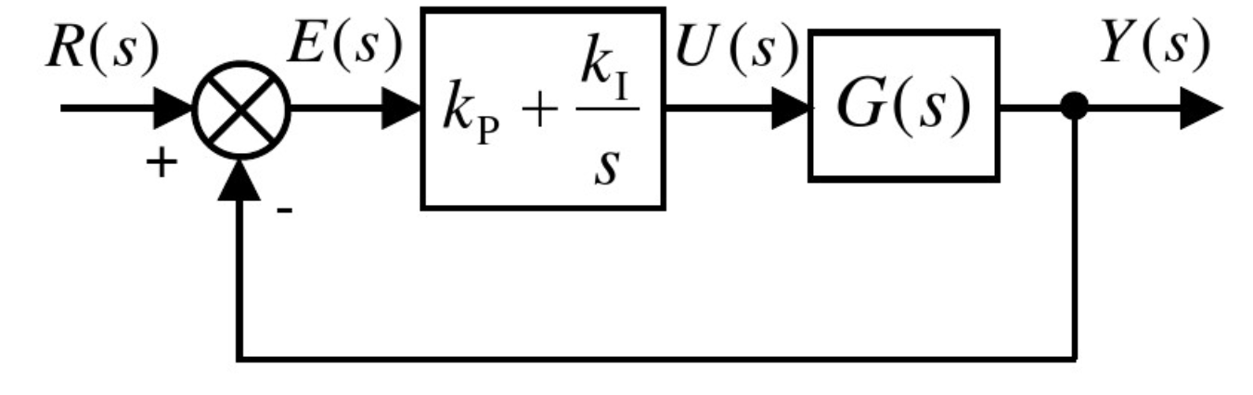
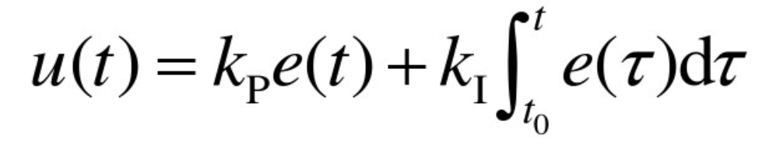
Motor Control – PID Control
PI -- Proportional Plus Integral control

Slide 26
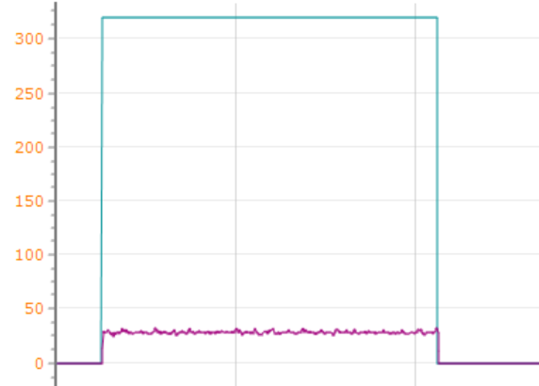
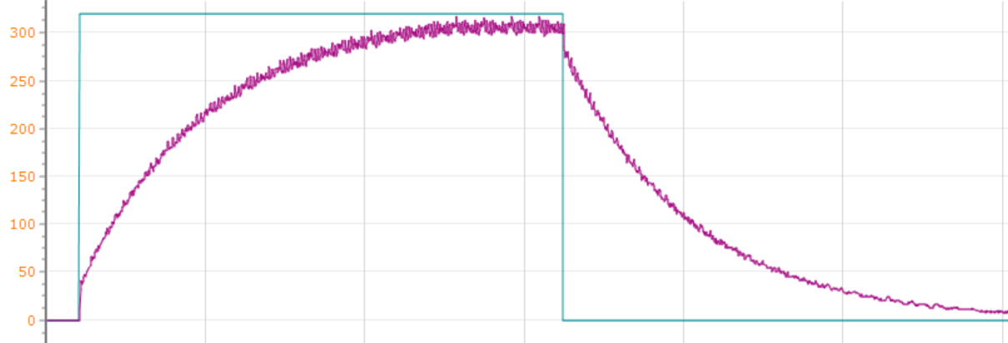
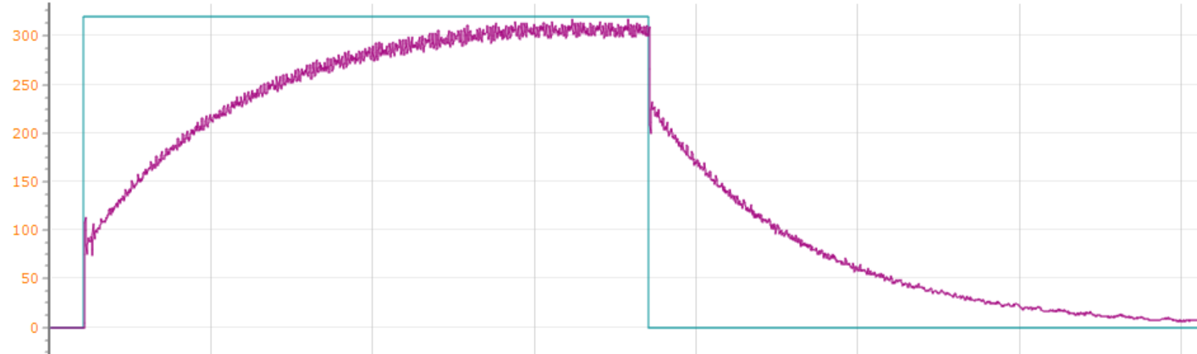
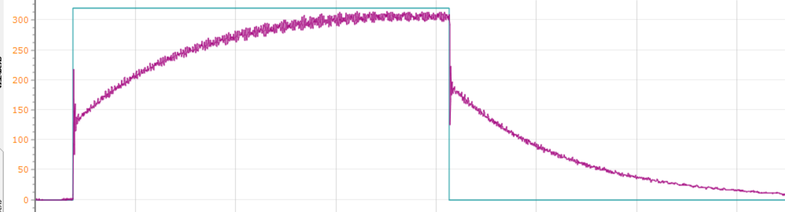
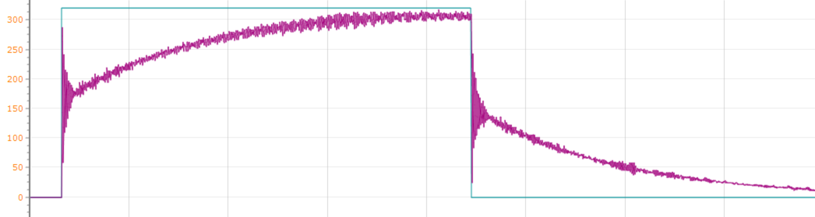
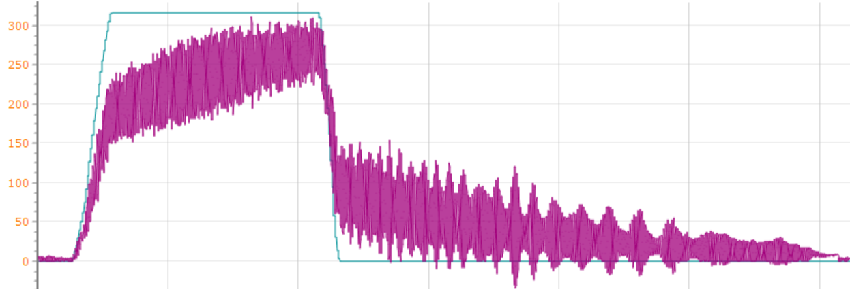
Motor speed waveform—PID control
P=10 I=0
P=10 I=0.1
P=30 I=0.1
P=50 I=0.1
P=80 I=0.1
P=100 I=0.1
P control
P=30

Slide 27
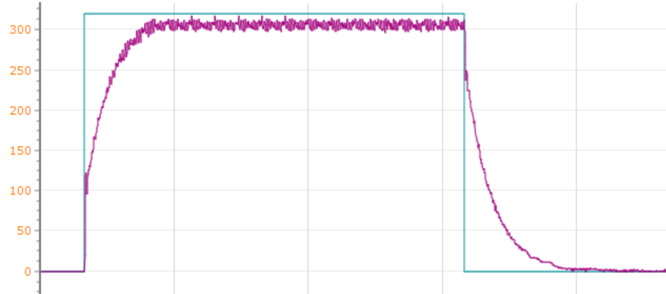
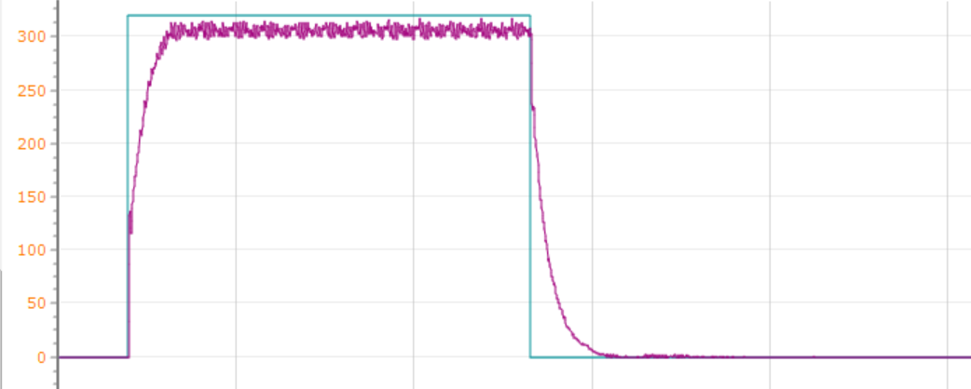
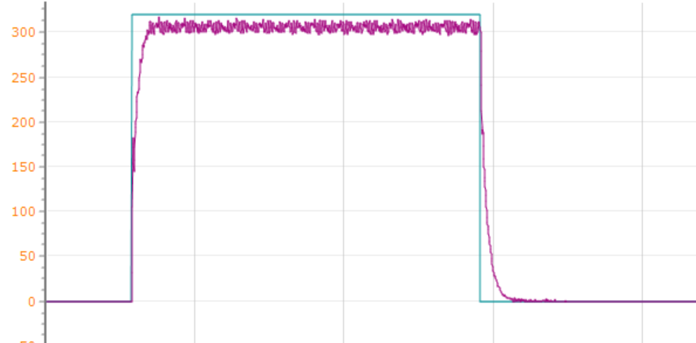
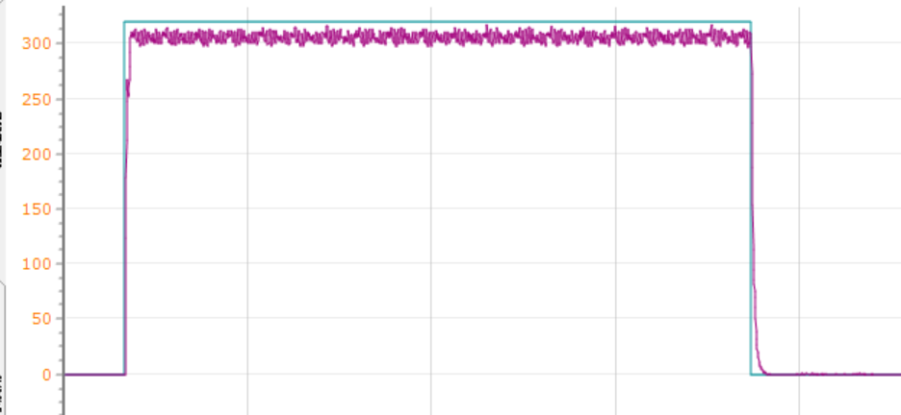
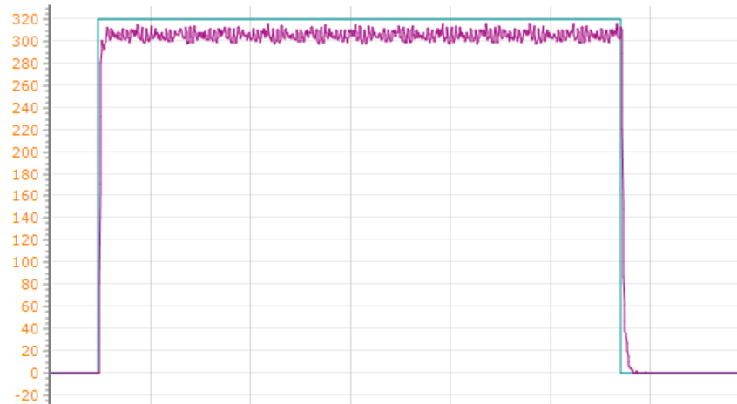
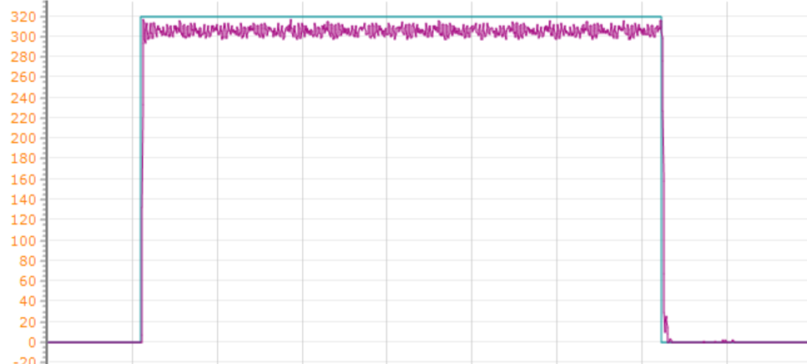
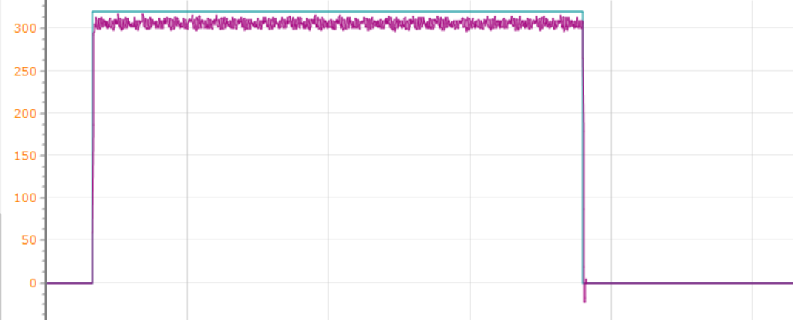
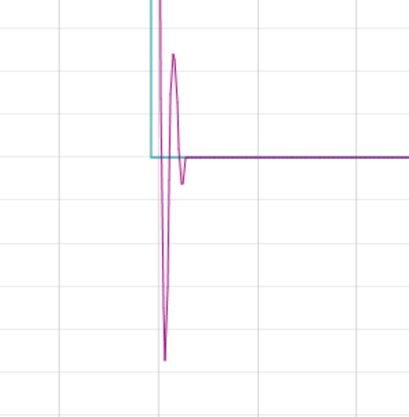
Motor speed waveform—PID control
P=30 I=0.1
P=30 I=0.5
P=30 I=1
P=30 I=2
P=3000 I=5
P=3000 I=7
PI Control
P=20 I=7
P=3000 I=8
P=3000 I=10

Slide 28
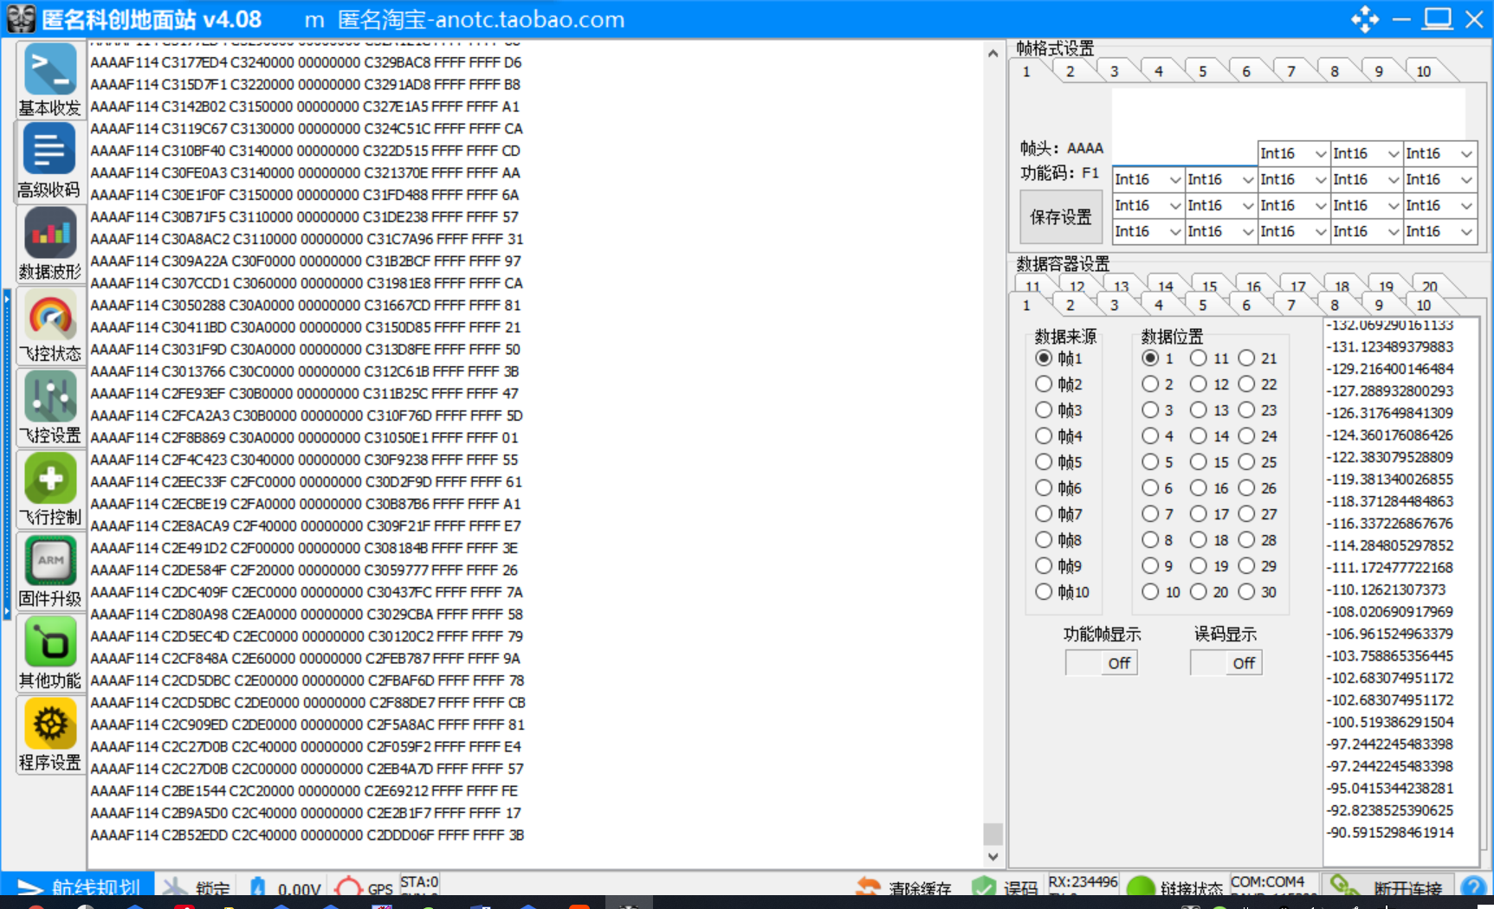
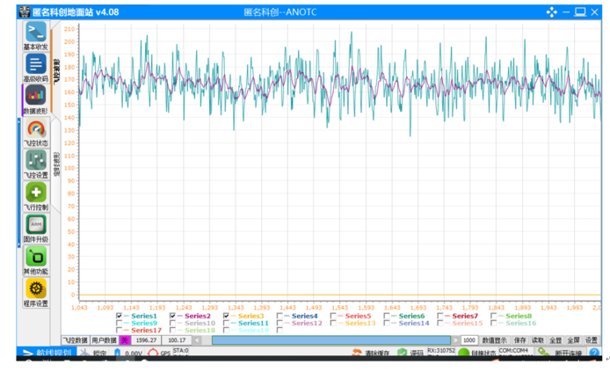
Serial port communication between STM32 with PC

Slide 29
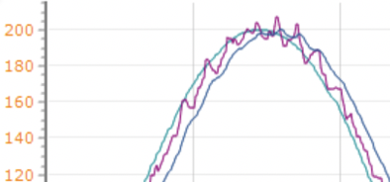
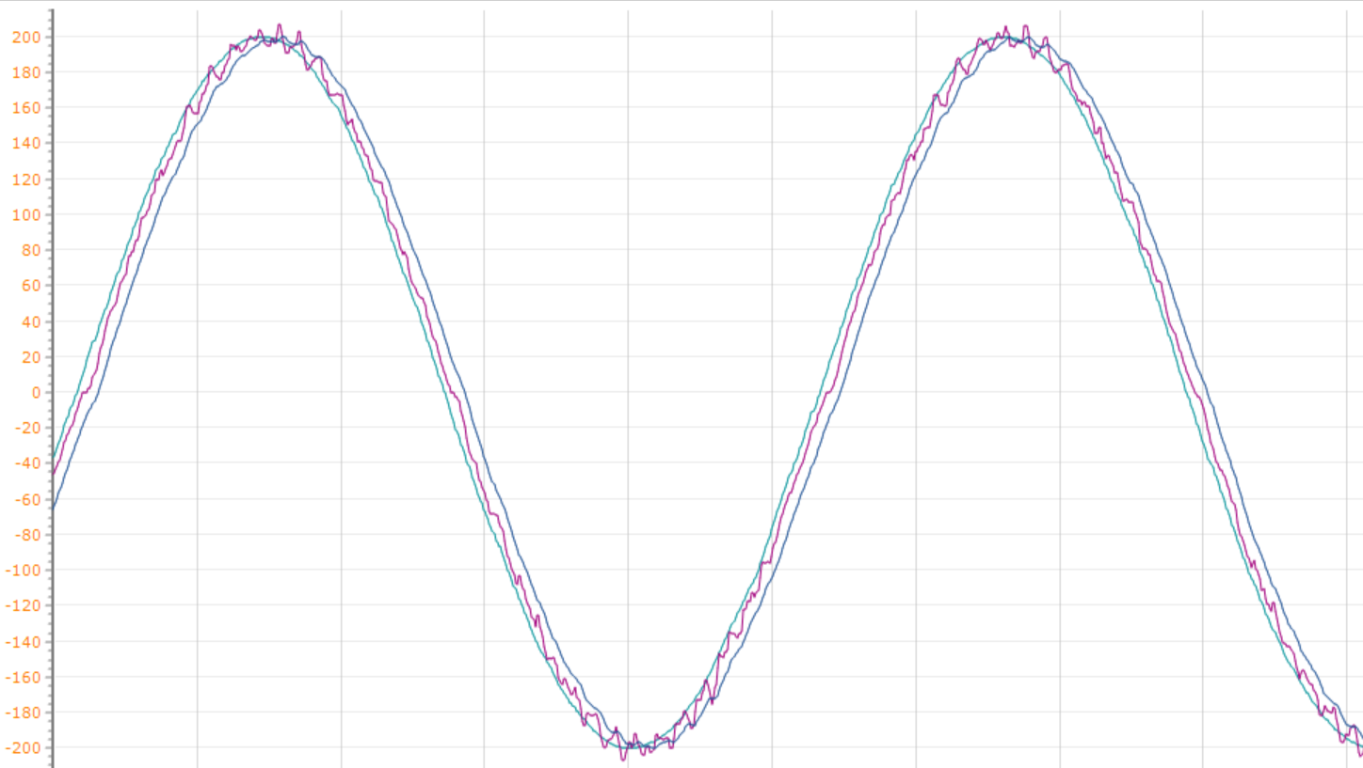
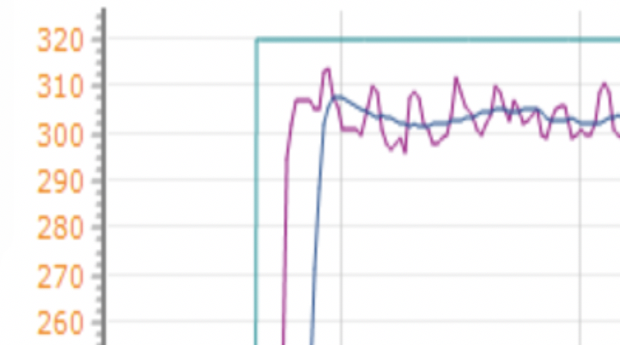
Kalman filtering
Green：target speed
Purple：speed feedback
Dark blue： speed feedback Kalman filter

Slide 30
Serial port communication in STM32 part
Raspberry Pi
Send a frame of data
STM32F4
Judge the data
Drop the data and respond to retrieve it
No
Yes
Receive data

Slide 31
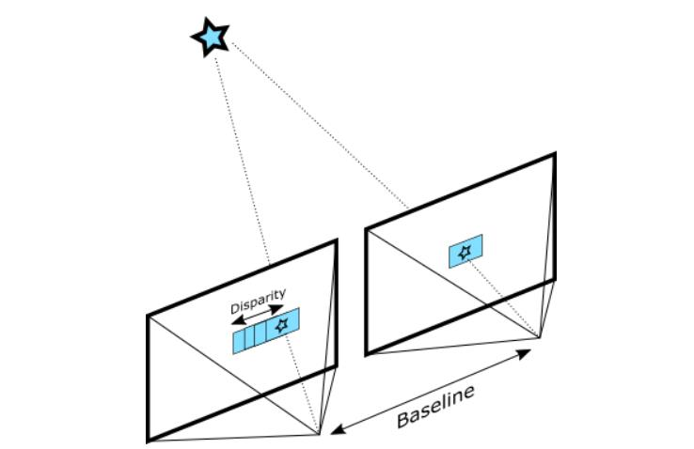
Structured-Light
Depth from Stereo is a classic computer vision algorithm inspired by human binocular vision system. It relies on two parallel cameras and calculates depth by estimating disparities between matching key-points in the left and right images.
We should ensure that the images are coming from two parallel views.But in fact,it is very hard.So calibration is always needed.
Similar triangles

Slide 32
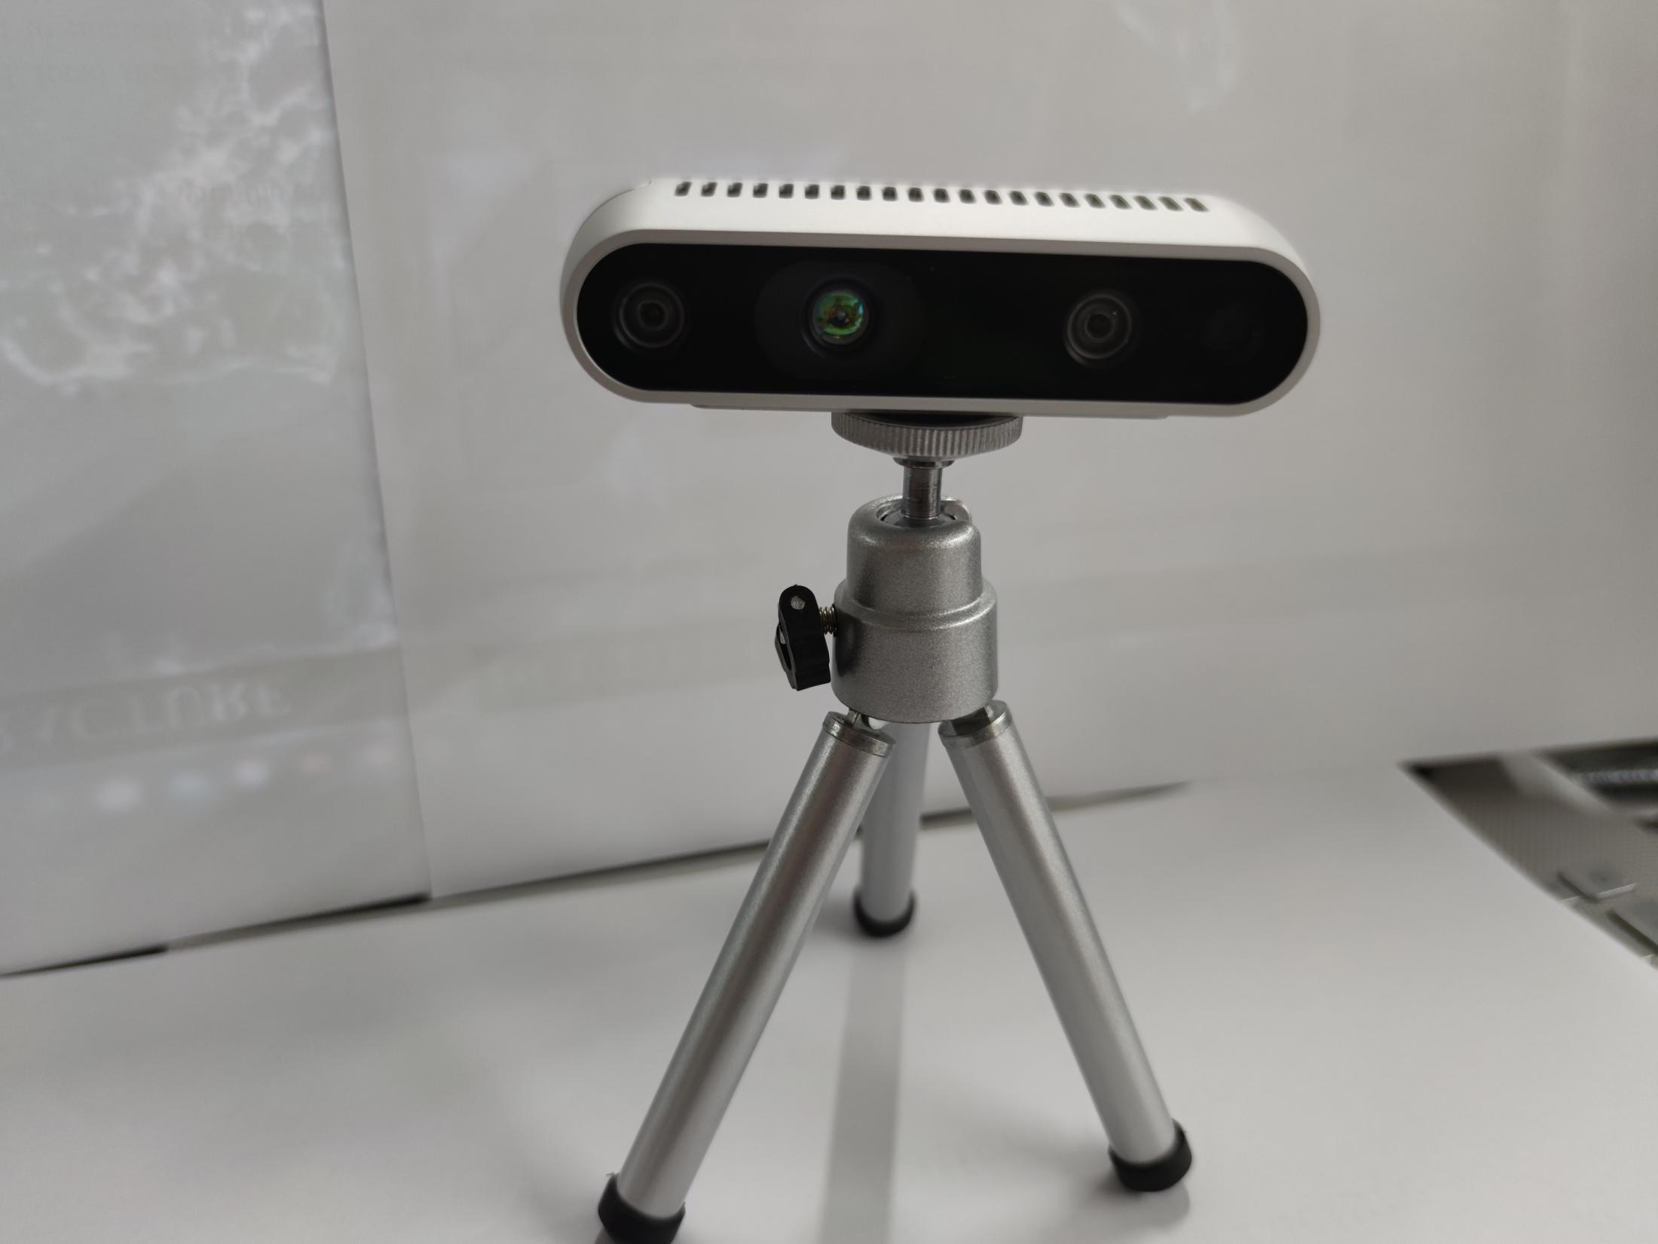
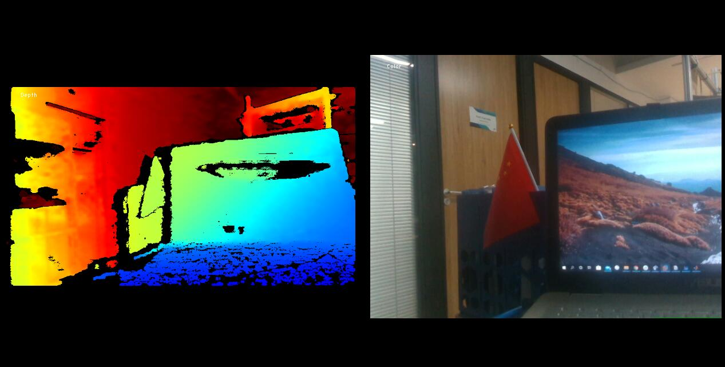
Depth camera
Intel RealSense D435
Depth image and RGB image

Slide 33

RGB image segmentation
Image segmentation based on color in HSV color space.
Select random points for region growth.Pixels are aggregated together based on similarity measure.
Image segmentation based on regional texture features.
HSV color space
Group small patches of 20x20 px with overlaps.

Slide 34
Depth camera
Another idea
Calibration
High Confidence Preset
Collision avoidance
Reason:
potential shaking
Environmental conditions
Downsample
Main Filter
Depth filter

Slide 35
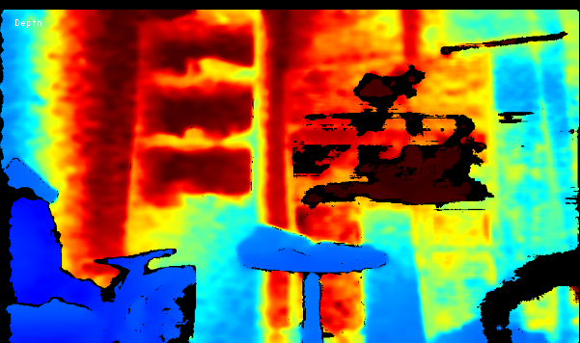

Depth camera
High Confidence Preset
Downsample
Main Filter
Core idea: well defined features are more likely to have high confidence corresponding depth

Slide 36
Depth camera
High Confidence Preset
Downsample
Main Filter
Four pixels to one pixel
pick the closest depth value instead of median value

Slide 37

Depth camera
High Confidence Preset
Edge filter:
sobel operator
Corner filter:
Harris Corner Detector
principle
Downsample
Color to grayscale
Spatial derivative calculation
Structure tensor setup
Harris response calculation
Non-maximum suppression
Main Filter
F(x) F’(x)

Slide 38

Depth camera
Final results
Image segment
Depth filter
Other part

Slide 39
Results
Video~

Slide 40


Github

Slide 41
Cost
Item type | Raspberry develop board4B | STM32 Development board | UWB Robot follow module | Ov2640 camera | USB-TAPEC converter | TF Memory card | UWB Positioning base station | UWB Positioning label
Amount | 1 | 1 | 1 | 1 | 1 | 1 | 2 | 1
Unit price（￥） | 725 | 425 | 1062 | 123 | 221 | 48 | 330 | 330
Total price（￥） | 725 | 425 | 1062 | 123 | 221 | 48 | 660 | 330
Total cost is ￥3594.

Slide 42
Experience

